Slide 1
Java Script
Day 2

Slide 2
Objectives
Understand
Loops and Iterating Array using loop
JS Functions
Creating functions
Function Expressions
Passing arguments to functions
Function scope
Arrow functions
Why?
Explain how the this keyword behaves in an arrow function
Optional, Named & Default values
REST parameters and the spread operator
JS Objects
Creating objects
Object Properties
Object methods
Enumerating object properties
De structuring syntax (array and object)
JS built-in objects (this can be given as a self study)
Array, Date, String, Math, Number

Slide 3
Loops and Iterating Array using loop
for - loops through a block of code a number of times
for/in - loops through the properties of an object
for/of - loops through the values of an iterrable object
while - loops through a block of code while a specified condition is true
do/while - also loops through a block of code while a specified condition is true

Slide 4
for
let employees = ["John", "James" , "Kevin", "Vinod"];
console.log(employees);
//for loop
for (let index = 0; index < employees.length; index++) {
const element = employees[index];
console.log(element);
}

Slide 5
for in
console.log("--------------for in--------------------");
for (const key in employees) {
console.log(employees[key])
}

Slide 6
for of
console.log("---------for of-------------------------");
for (const emp of employees) {
console.log(emp);
}

Slide 7
While loop
console.log("--------------while loop--------------------");
let i=0;
while(i<employees.length){
console.log(employees[i]);
i++;
}

Slide 8
do while
console.log("--------------do while loop--------------------");
let j=0;
do{
console.log(employees[j]);
j++;
}while(j<employees.length);

Slide 9
Java Script strict mode.
Strict mode is use in Java script in order to prompt developer to fix some bugs which couldn’t be identified without strict mode.
Sometimes if there will be any bug in our code but our HTML page will be rendered successfully but we can’t get desire output and we couldn’t find main reason. So in order to avoid such scenario it’s best practice to use strict mode.
How to use strict mode.
Add ‘use strict’ at the top or first line of our HTML code.
Comments can be added on top of it but you shouldn’t add any line of code on top of it.

Slide 10
Java Script strict mode.
'use strict';
// if a person is not having driv. Lic.
// but if person has passed driv test then person can get driv. lic
let hasLic = false;
let passDrivTest = true;
if(passDrivTest) hasLice = true; //first type hasLice
if(hasLic) console.log("I can drive vehicle");
now ="bhushan"; //don't use let and try without use strict
console.log(now);
const stName ="Bhushan";
const interface ="Santosh"; //don't use let and try without use strict

Slide 11
JS Functions
In general English function is some action supposed to happen.
In programming language , function we can say it’s set of instructions to perform some operation / action.
We can implement function in JS.
Syntax for js
Function functionName(){
Function body-------------
---------------------------------
}
Note → We can create function when few line of code we will have to use multiple times to perform some operation.

Slide 12
Function in js
// //function declaration
Function without parameter without return type
function displayGreetings(){
console.log("Good Morning");
console.log("Have Happy Weekends");
console.log("Have a good day");
}
console.log("-----Hello Guys-----------")
displayGreetings();

Slide 13
Function in js
2. Function without parameter with return type.
function getStudentNameNew(){
return "James";
}
const stName= getStudentNameNew();
console.log(stName);

Slide 14
Function in js
3. Function with Parameter with return type
function getEmpInfo(empName)
{
const empDetails= `${empName} from HR`;
return empDetails;
}
let empD = getEmpInfo('Kevin')
console.log(empD);

Slide 15
Function in js
4. Function with parameter without return type
function displayEmpInfo(empId,empName, empAddress){
let empInfo=`ID of Employee =${empD}- Name of Employee =${empName}
Address of Employee =${empAddress}`;
console.log(empInfo);
}
displayEmpInfo(101,'James','Mumbai');

Slide 16
Function calling other Function
In JS we can call another function from one function.
We will understand this using a simple example.
Scenario.
We have a function which is responsible for making juice from apples and oranges, which we have seen before but now we will need one more function which will cut apple and oranges in pieces to make juice efficiently.

Slide 17
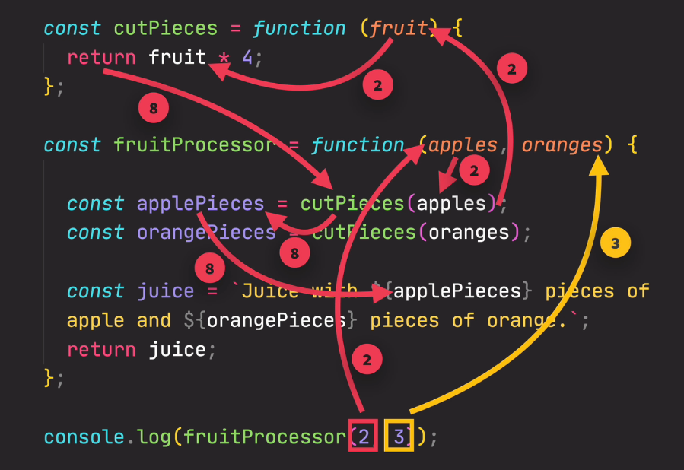
Function calling other Function

Slide 18
Function calling other Function
function makeJuice(apples, oranges){
console.log("Juice is prepearing .....");
const peicesOfApples = cutIntoPieces(apples);
const piecesOfORanges = cutIntoPieces(oranges);
let message =`Juice is ready with ${peicesOfApples} pieces of apples and ${piecesOfORanges} pieces of oranges`;
console.log(message);
}
function cutIntoPieces(fruits){
return fruits*4;
}
makeJuice(2,4);

Slide 19
Function Declaration Vs Expression
Function declaration and Function expression is quite look similar but in case of function expression as anonymous function because it doesn’t has any name.
Biggest difference which can be seen easily is that we can call function which implemented using function declaration but in case of function expression we can’t call before defining function expression.

Slide 20
Function as an Expression
//function as expression
const addressOfCompany = function(location){
return `Company is situated at ${location}`;
}
const addr=addressOfCompany('Mumbai');
console.log(addr);

Slide 21
Function as an Expression
// //function as expression
const displayCity = function(cityName){
return `Welcome to ${cityName}`;
}
// //calling function as expression
console.log(displayCity('Mumbai'));
// //function as expression
// // function as parameter with return type
const calculateAge = function (yearOfBirth){
const currentYear=2022;
let age=2022-yearOfBirth
return age;
}
// //calling function as an Expression
let ageOfStudent1= calculateAge(1992);
console.log(ageOfStudent1);

Slide 22
Arrow function
Arrow function is added in ES6.
It is also form of function expression but it is smaller and shorter so it’s faster in implementation.
Return value implicitly. We no need to return anything explicitly if it will be a single line arrow function.
If arrow function is having multiple lines then we will have to return value explicitly.
If there will be multiple parameter then we will have to use parenthesis( par1,par2)
Arrow function is very easy to use but only one problem with arrow function is that arrow function can’t combine with this keyword.

Slide 23
Array
Array is one of data structure in JS. Which is responsible for storing multiple values.
Syntax → const students = [‘xyz’,’abc’,’lmn’];
Const employee = new Array(‘xyz’,’abc’, ‘lmn’);
Note- (Even if we are using const to declare array but we can change values in array. Because these are not primitive values. It means even if our array declared as const but we can mutate it’s value.)

Slide 24
Arrow Function:
// //Arrow Function
const studentName = stName=>`Name of Student ${stName}`;
console.log("------------Arrow--------------");
let sname = studentName('XYZ');
console.log(sname);
// //Scenario == provide a birth year of a person and fro that our function will return , how many years left for retirement.
// // implement using arrow function
const yearLeftForRetire = (empBirthYear,empName) =>{
// first we will have to calculate person's age
const currentAge =2021-empBirthYear;
const yrLeftForRet = 60-currentAge;
return `${empName} is going to retire in ${yrLeftForRet} years`;
}
console.log(yearLeftForRetire(1985, 'Santosh'));

Slide 25
Basic Array Operations (Methods)
There are some methods are available to manipulate arrays.
Push → this method will add element in array at end.
Unshift → this method will add element at beginning.
Pop → this method is use to delete last element from last index.
Shift → this method is use to delete/remove first element from array
indexOf → it will gives index of specific element.
Includes → this method will returns true or false depends on existence of element in array.

Slide 26
Declaring Array
// Arrays declaration
//way 1
const Employees = ['James', 'Jason','Kevin','Keanu','David'];
console.log(Employees);
//way 2
const Students = new Array('Linda','Vina','Sita','Dev');
console.log(Students);

Slide 27
Methods of Array
//Methods of Array
//length
console.log(Students.length);
// //elements in array going to start from 0th index
// //length count is going to start from 1
console.log(Students[Students.length-1]);
Students[4]='Aman';
Students[0]="Nayan";
console.log(Students);

Slide 28
Methods of Array
//Methods for Array
const emp =['James', 'John','Jason','Simon'];
console.log(emp);
const newLength = emp.push('Eric');
console.log(emp);
console.log("New Length of Students = "+newLength);
emp.unshift('Amber');
console.log(emp);
const deletedEmp=emp.pop();
console.log("Value of Deleted Employee ="+emp);
console.log(emp);
emp.shift();
console.log(emp);
console.log(emp.indexOf('Jason'))
console.log(emp.includes('Bhushan'));

Slide 29
Object
Object is also a data structure in JS.
It is also use to save multiple relative values/ elements as key value pair.
Syntax for declaring object
Const stdinfo ={
key : value
ex.
firstName : ‘Bhushan’,
lastName : ‘XYZ’
};

Slide 30
Manipulate data of object using dot and bracket.
We can access properties in object using ( . ) or ( [ ] )
We can add more properties using . And [ ].

Slide 31
Object
console.log(tataNexon.modelName+'-'+tataNexon.chesisNumber);
tataNexon.carColor='blue';
console.log(tataNexon.carColor);
const tataNexon = {
modelName:'Tata Nexon',
chesisNumber:123456,
carColor: 'Red',
carPrice: 13.5,
carFeature: 'Electric Vehicle',
yearOfMan:2022
}
console.log(tataNexon.chesisNumber+"-"+tataNexon.carColor+"-"+tataNexon.carPrice);
tataNexon.carColor="blue";
console.log(tataNexon.chesisNumber+"-"+tataNexon.carColor+"-"+tataNexon.carPrice);
console.log(tataNexon['chesisNumber']+"--"+tataNexon['carColor']+"--"+tataNexon['carPrice']);
tataNexon['carColor']='white';
console.log(tataNexon['chesisNumber']+"--"+tataNexon['carColor']+"--"+tataNexon['carPrice']);
//add additional property using []
tataNexon['carSegment']="Compac SUV";
console.log(tataNexon['chesisNumber']+"--"+tataNexon['carColor']+"--"+tataNexon['carPrice']
+"--"+tataNexon['carSegment']);
//add additional property using .
tataNexon.carWeight=1200;
console.log(tataNexon['chesisNumber']+"--"+tataNexon['carColor']+"--"+tataNexon['carPrice']
+"--"+tataNexon.carWeight);

Slide 32
Methods in Java Script Object
For any Object we can create a method inside it. For example:
const Batch2Folks ={
first_name:’Ravi',
last_name:'Kumar',
ct_id:101,
full_name:function(){
return this.first_name+" "+this.last_name;
}
}

Slide 33
Calling Object Method
//Object Oriented Methods
const Batch2Folks ={
first_name:'Yash',
last_name:'Kumar',
ct_id:101,
year_of_birth:2000,
full_name:function(){
return this.first_name+" "+this.last_name;
},
age_of_student:function(){
return 2022-this.year_of_birth
}
}
//Accessing Object methods
let fName = Batch2Folks.age_of_student();
let tAge =Batch2Folks.full_name();
console.log(`Trainees Full Name = ${fName}`);
console.log(`Trainees age = ${tAge}`);

